Slide 1

STUDENT LIFE MANAGEMENT SYSTEM
TEAM:
KAVYA RAVI
SANTHOSH REVOORU
MASON KELLEY

Slide 2
INTRODUCTION
Student Management system can handle all the required details about the student information and activities.
Student Management system is an automated version of manual student management system

Slide 3
SYSTEM IMPORTANCE
Manages information system for education establishments to manage student data.
It specifically relates to students and the courses, student I’d, attendance, fee status, exam queries, and subjects.
The system ensures data integrity, privacy, and security.
It is accessible to all students and faculty with a different version and accessibilities to each.

Slide 4
ENTITIES
Student(SID, sName, sDOB, email)
Enrollment(E_ID, E_Date)
Exam(Grade, Percentage)
Subject(SubjectID, Name)
Course(CID, Date, Faculty)
Class(C_ID, Date, Max_value)
Attendance(AID, Year, Month)

Slide 5
Relationships
Enrolled(Student_ID, Enrollment_ID)
Takes(Student_ID, Exam, Dept_ID)
Given(Dept_ID, Grade)
Has(Enrollment_ID, Grade)
Paid(Enrollment_ID, Fees)

Slide 6
CONSTRAINTS
One student can take a maximum of 5 subjects at a time.
Student must pay full fee before enrolling.

Slide 7
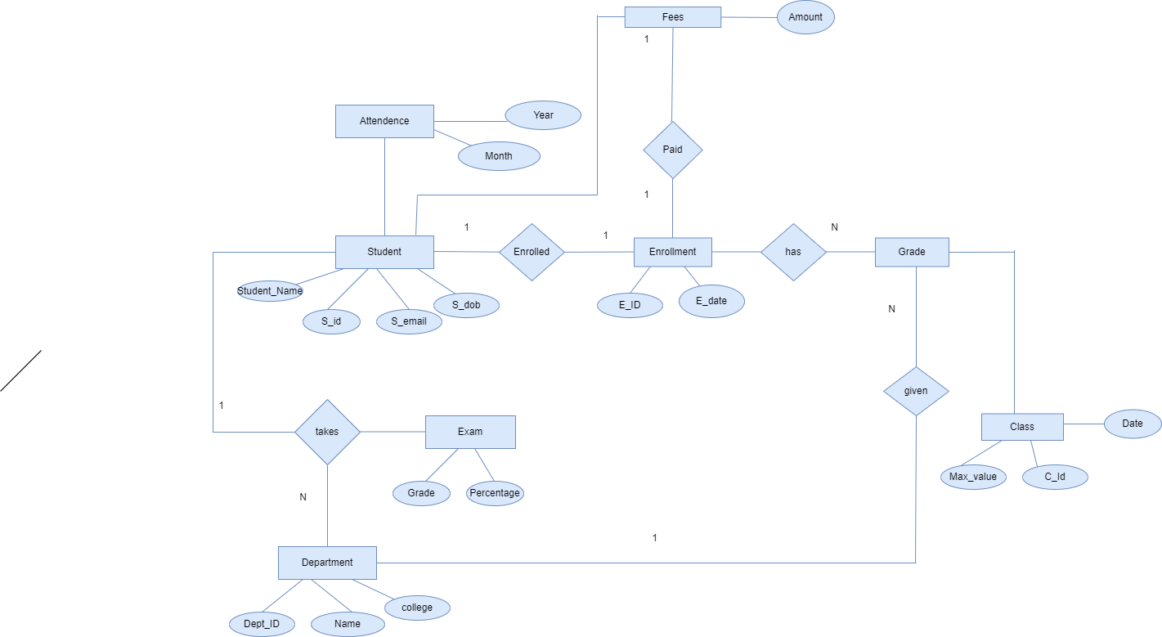
ER DIAGRAM

Slide 8
Timeline
1st week – Create SQl tables, DDL commands.
2nd week – Create and Import data.
3rd Week – Create DML commands
4th Week – Create user interface

